Slide 1
Clinical Advice in Community Pharmacies: Findings from a national audit
Add name of presenter here

Slide 2



Community pharmacy: an introduction
11,200 pharmacies in England situated in high-street locations, supermarkets and residential neighbourhoods
89% of the population can reach their local community pharmacy within a 20 minute walk
An estimated 1.6 million visits take place daily, of which 1.2 million are for health-related reasons

Slide 3
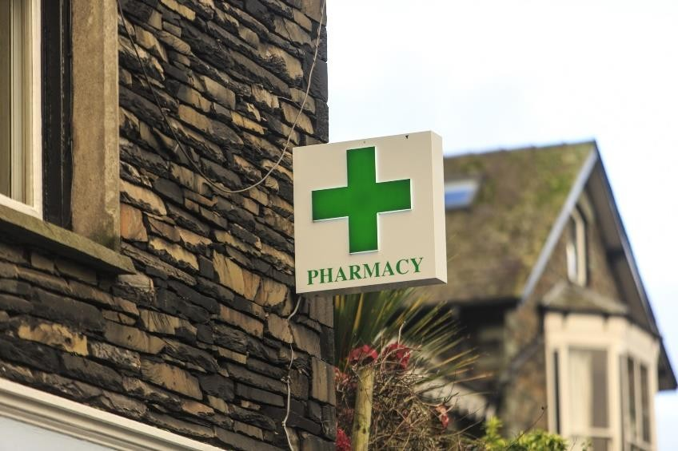
A first port of call for minor health conditions
Pharmacies long promoted as a first port of call by the NHS
Nearly all pharmacies are Healthy Living Pharmacies
Formal route for referrals for minor conditions from NHS 111 via the Community Pharmacist Consultation Service (CPCS)
Referrals from GP practices rolling out this autumn

Slide 4
A first port of call for minor health conditions
Pharmacies do not record individual advice consultations with patients
But patients seem to be visiting them more and more
A recent PAGB survey found people were more likely to visit a pharmacy for advice since the COVID-19 pandemic
We expect this trend to continue

Slide 5

Pharmacy funding for advice consultations
CPCS referrals have a fee attached: over 300,000 consultations since October 2019
Core pharmacy funding does include some monies for ‘self-care’ advice
But this is not linked to the actual numbers of people pharmacies help…
… and this role is increasing beyond what national negotiators believe is covered by this funding element

Slide 6
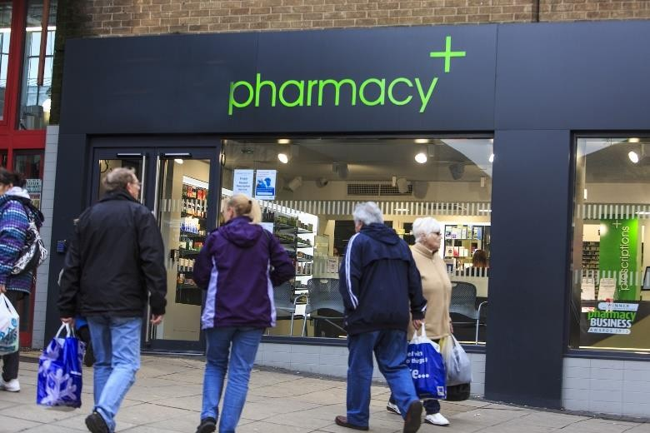
PSNC’s Pharmacy Advice Audit
PSNC is the national negotiator for community pharmacies
They asked pharmacies to record their patient consultations on a single day in June or July 2020
9,411 pharmacies in England took part
198,043 patient consultations were recorded
All of these were outside formal referral routes
The average pharmacy carries out around 15 of these informal patient consultations per day

Slide 7
What do the consultations look like?
79% were carried out face-to-face
20% were carried out by telephone, with very few carried out online
63% of patients required the pharmacy team to respond to their symptoms
18% sought help for an existing medical condition
9% needed healthy living advice

Slide 8
What do the consultations look like?
92% resulted in advice being given
In just 49% of consultations this was accompanied by the sale of a medicine
Appropriate advice alone was given in 43% of consultations
The average staff time per consultation was just over 5 minutes
Around 75 minutes per day, per pharmacy, is spent providing this advice

Slide 9
Reducing pressure on other parts of the NHS
Fewer than 10% of the consultations resulted in patients being referred to their GP
Yet 49% of patients said that if the pharmacy had not been there, they would have visited their GP
A further 5.7% would have visited A&E / Walk-in centre
This suggests that if pharmacy advice were taken away, there could be 492,000 additional GP appointments each week, or 65 appointments in each GP practice each week in England

Slide 10
Conclusions
Patients value the advice that they can receive from local pharmacies…
… and this is taking considerable pressure of other parts of the NHS
But pharmacies are struggling to sustain this level of support given the financial and workload challenges they face, particularly in light of the pandemic
Pharmacies need appropriate funding and support for their critical role

