Slide 1
Read and delete this slide
This Community Pharmacy England presentation on the Pharmacy First service is for use by LPCs when running local events on the service
Further information on the service is available at cpe.org.uk/pharmacyfirst
Presenters should first read the service specification and the FAQs on the Community Pharmacy England website, and familiarise themselves with the clinical pathways, Patient Group Directions and protocol. The content of these documents/resources provide the key information and additional background knowledge for anybody giving this presentation at an event
Presenters may also want to watch the Community Pharmacy England Pharmacy First: Getting to know the service webinar available at cpe.org.uk/webinars, as this presentation is based on the PowerPoint used during the webinar
Questions or comments on this presentation can be addressed to the Services Team: services.team@cpe.org.uk ​
You can pick and choose the elements of the presentation that suit the needs of your event/discussion. There is also some text highlighted in yellow in the presentation that will need to be amended/deleted depending on when the local event is held, availability of other local training events, etc
Last updated: 21st May 2024

Slide 2
Pharmacy First: Getting to know the service

Slide 3
Presentation overview
Strategic context for the service​
Summary of the service requirements​
The clinical pathways and PGDs​
Learning and development requirements​
Preparing to provide the service​
Q&A

Slide 4

The Pharmacy First service
Community Pharmacy England submitted proposals for a Pharmacy First service to DHSC and NHS England in March 2022​
This was followed up with a comms and lobbying campaign​
On 9th May 2023, DHSC and NHS England published the Delivery plan for recovering access to primary care​
This included a commitment to commission a Pharmacy First service, allowing the treatment of seven conditions​
The service started on 31st January 2024

Slide 5
The Pharmacy First service
Pharmacy First is an Advanced service that will include seven clinical pathways and replaces the Community Pharmacist Consultation Service (CPCS)
The service consist of three elements:
Clinical pathway consultations
new element
Urgent supply of repeat meds and appliances
previously part of CPCS
Electronic referrals for minor illness consultations
previously part of CPCS

Slide 6
What are the seven conditions?
Sinusitis
12 years and over
Sore throat
5 years and over
Acute otitis media
1 to 17 years
Infected insect bite
1 year and over
Impetigo
1 year and over
Shingles
18 years and over
Uncomplicated UTI
Women 16 to 64 years

Slide 7
The Pharmacy First service
Pharmacies opting-in must provide all three elements of the new service
Patients can present to the pharmacy for clinical pathways consultations (only)
Clinical pathways consultations can be provided remotely, except for the acute otitis media pathway (otoscope required)
Remote consultations must be via high-quality video link
DSPs can only provide clinical pathways consultations remotely (due to the link to Essential services)
They cannot provide the acute otitis media pathway (otoscope required)
There are no changes to the former CPCS elements of the service, e.g. electronic referrals are still required and telephone consultations are still possible, where clinically appropriate

Slide 8
Summary of the service requirements

Slide 9
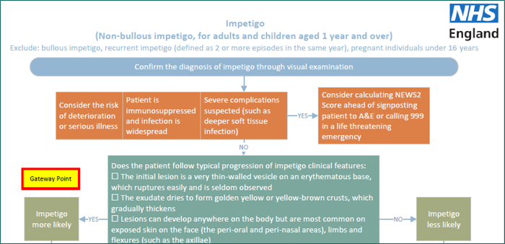
Clinical pathways consultations
Service spec and seven clinical pathways developed
23 associated PGDs and one clinical protocol (P med)
The clinical pathways contain one or more Gateway points
For a patient to be eligible to receive a clinical pathways consultation, a Gateway point must be passed

Slide 10
High-level service overview
Electronic referral
Patient presents to the pharmacy
Gateway
met
Urgent repeat meds referral
Minor illness referral
Clinical pathway referral
Gateway
met
Gateway
not met
Gateway
not met
Urgent repeat meds consultation
Minor illness consultation
Clinical pathway consultation
Self-care Essential service
A more detailed service pathway diagram can be found in Annex A of the service spec

Slide 11
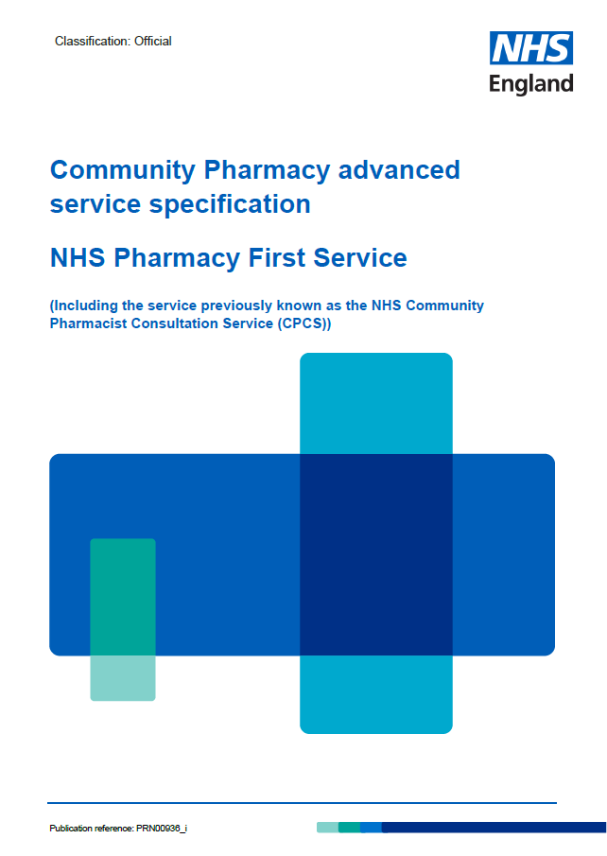
The service requirements
Complying with Terms of Service requirements for Essential services and clinical governance​
Have a consultation room meeting the ToS requirements, with access to IT equipment for record keeping​
Equipment – otoscope – see buying advice in Annex C of the spec​
Standard operating procedure, including the process for escalation​
Competency and training requirements​
Have an NHS-assured clinical IT system​
Sign-up to provide the service on MYS​
Where supplies of an NHS medicine are made, the normal prescription charge rules apply

Slide 12



Funding
Funding for the clinical pathways consultations comes from the additional £645m provided to support the recovery plan
  £15 fee per completed consultation

Slide 13
Funding
A monthly fixed payment of £1,000 where the pharmacy meets a minimum number of clinical pathways consultations:
From April 2024, an initial cap of 3,000
consultations per month per pharmacy
was put in place
From October 2024, new caps will be
introduced based on actual provision of
clinical pathway consultations, designed to
deliver 3 million consultations per quarter
Month | Minimum number of clinical pathways consultations
February 2024 | 1
March 2024 | 5
April 2024 | 5
May 2024 | 10
June 2024 | 10
July 2024 | 10
August 2024 | 20
September 2024 | 20
October 2024 onwards | 30

Slide 14
The clinical pathways and PGDs

Slide 15
Clinical pathway consultations
The clinical pathways element enables the management of common infections by community pharmacies through offering self-care, safety netting advice, and only if appropriate, supplying a restricted set of medicines to complete episodes of care for seven common conditions
NHS England commissioned Specialist Pharmacy Service to develop patient group directions (PGDs) and a protocol for the Pharmacy First service
The final PGDs and protocol, published on the NHS England website, have received national approval from the National Medical Director, Chief Pharmaceutical Officer and National Clinical Director for IPC & AMR

Slide 16
Development of clinical pathways
Multi-professional expert working group to develop robust clinical pathways for each of the 7 conditions
Adherence to NICE guidelines
National template for PGDs developed by SPS
Pharmacy Quality Scheme antimicrobial stewardship foundation
AMR Programme Board Oversight National Medical Director and Chief Medical Officer for England

Slide 17
Monitoring and surveillance
NHS England is closely monitoring delivery of the Pharmacy First service to allow for robust oversight and monitor for any potential impact on antimicrobial resistance so that any needed mitigations can be quickly actioned
NHS England is working with the NHSBSA to enable pharmacy reimbursement and functionality for PGD supply to be recorded via ePACT2 data, or in a parallel dashboard
NIHR has commissioned an evaluation of the Pharmacy First service to consider the implications for antimicrobial resistance

Slide 18
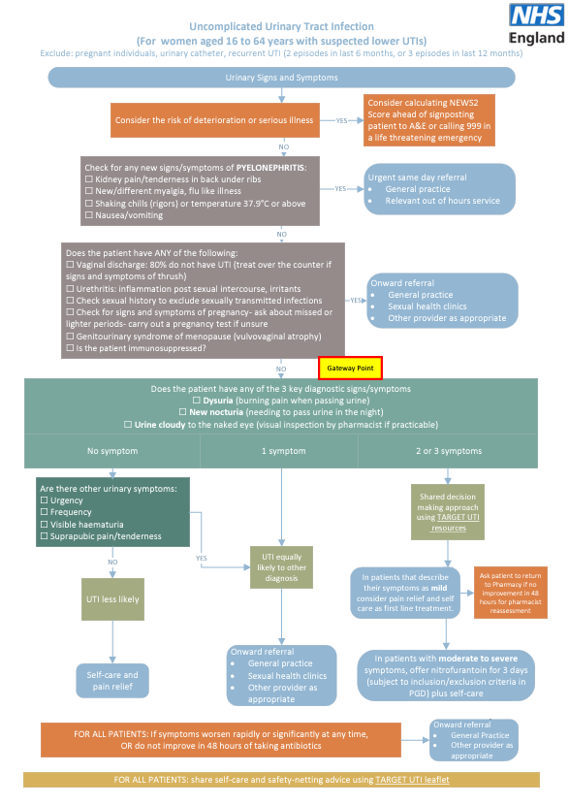

Slide 19
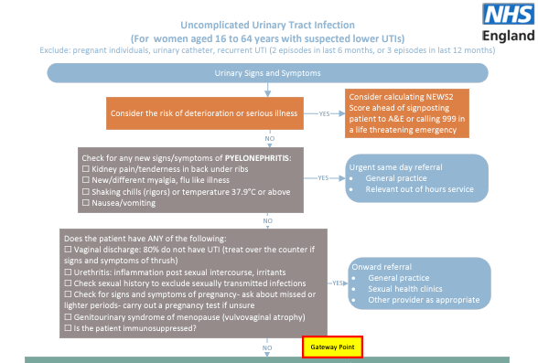

Slide 20
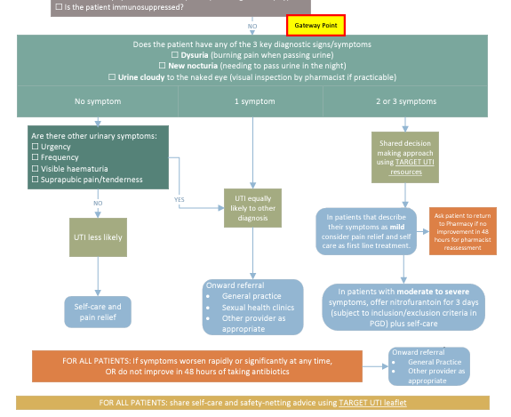

Slide 21
PGDs
Pharmacists need to read all 23 PGDs and protocol
Pharmacists must read and sign the PGDs and protocol
  There is a master PGD and protocol authorisation sheet on the NHS England website that pharmacists can use – this replaces the need to sign each individual PGD and protocol

Slide 22
Learning and development requirements

Slide 23
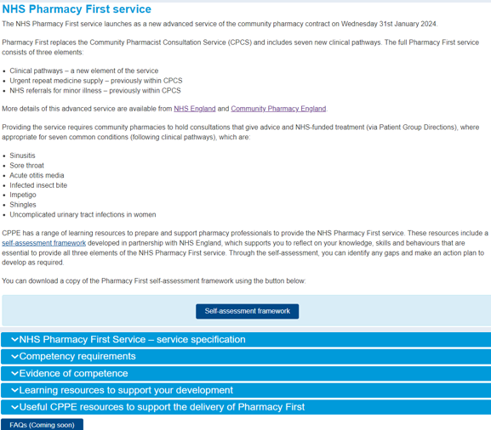
Learning and development
CPPE webpage detailing training resources
  www.cppe.ac.uk/services/pharmacy-first/
Pharmacy First self-assessment framework – developed by CPPE and NHS England
Personal development action plan

Slide 24
Learning and development
NHS England funded training by Cliniskills
  Clinical examination skills includes e-learning and face-to-face training [LPCs can add relevant local training dates from the website]
CPE Pharmacy First on-demand webinars:
  Getting to know the service
  Getting ready for launch
Available at: cpe.org.uk/pharmacyfirst

Slide 25
Preparing to provide the service

Slide 26
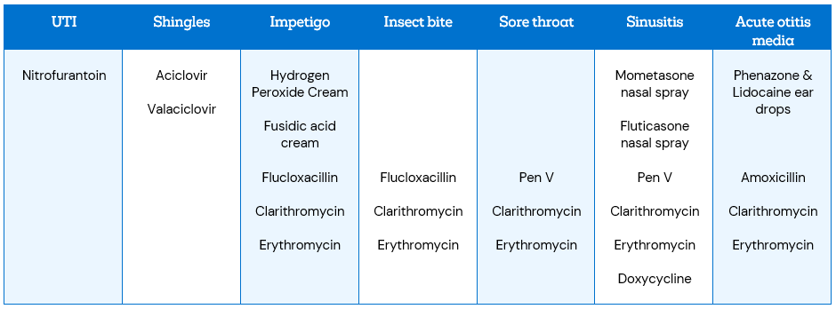
Preparing to provide the service
Download and read the service specification and clinical pathways​
If you then want to provide the service, sign up on MYS
Place an order for an otoscope​
Download and start​
  reading the PGDs and​
  clinical protocol

Slide 27



Preparing to provide the service
Start considering which IT system you want to use and look into costs and contracting​
Provide an initial briefing on the service for your staff​
Create a training plan with pharmacists who will provide the service (using the CPPE self-assessment), including ensuring they know how to use an otoscope​
Check our LPC website for details of any local training sessions​
Start to develop an SOP or update your CPCS SOP

Slide 28
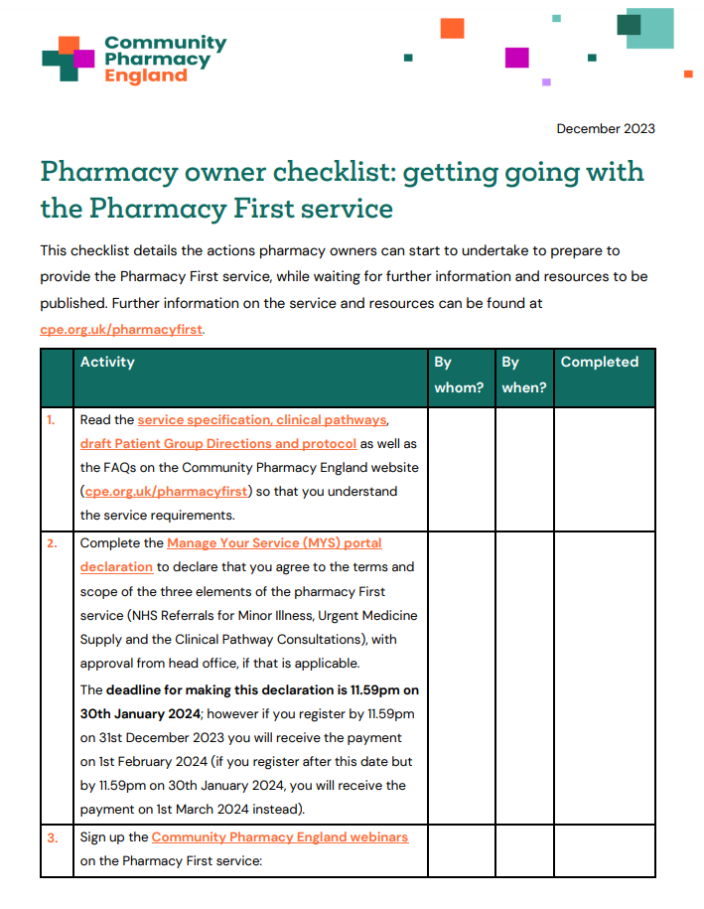
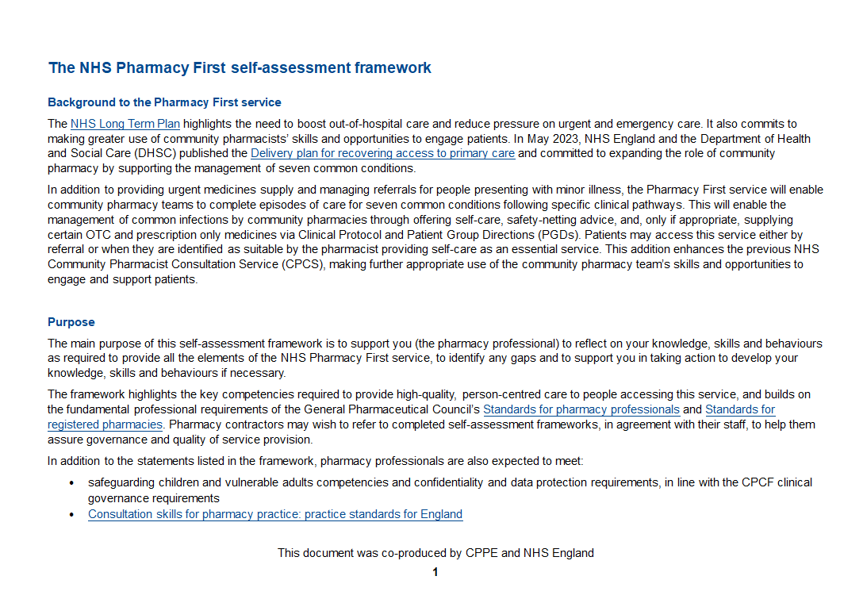
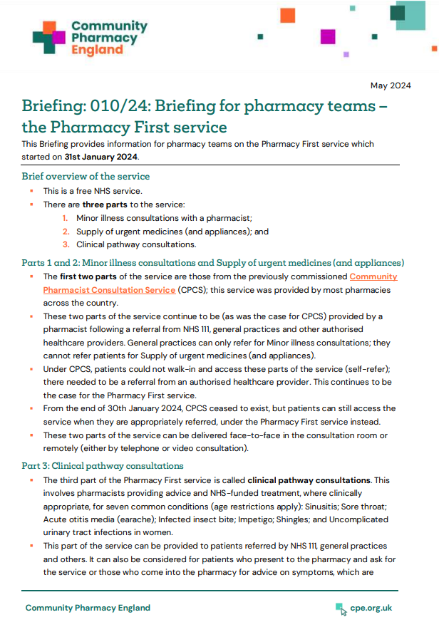
Resources to help you get ready
Checklists of things to do to prepare for the service for pharmacy owners and pharmacists​
CPPE Pharmacy First webpage and self-assessment
framework​
Cliniskills training modules and locally organised
training options​
Summary briefing for pharmacy team members

Slide 29



Promoting the service
NHS England launched a marketing campaign for the service in February 2024 – promotional materials are available for pharmacy teams to download
LPCs have been briefing Local Medical Committees and general practices about the service
  A briefing for LMCs and general practice teams, along with other resources is available at cpe.org.uk/pharmacyfirstGPs
Community Pharmacy England has a range of promotional materials available
Links to the NHS England and Community Pharmacy England resources can be found at: cpe.org.uk/pharmacyfirst

Slide 30

Questions cpe.org.uk/pharmacyfirst

