Slide 1
Read and delete this slide
This Community Pharmacy England presentation on the Pharmacy First service is for use by pharmacy owners/teams when presenting on the Pharmacy First service to GP practice teams.
Further information on the service is available at cpe.org.uk/pharmacyfirst
Presenters should first read the service specification and the FAQs on the Community Pharmacy England website, and familiarise themselves with the clinical pathways, Patient Group Directions and protocol. The content of these documents/resources provide the key information and additional background knowledge for anybody giving this presentation at an event
Presenters may also want to watch the Community Pharmacy England Pharmacy First: Getting to know the service webinar available at cpe.org.uk/webinars, as this presentation is based on the PowerPoint used during the webinar
Questions or comments on this presentation can be addressed to the Services Team: services.team@cpe.org.uk ​
You can pick and choose the elements of the presentation that suit the needs of your event/discussion. There is also some text highlighted in yellow in the presentation that will need to be amended/deleted depending on the audience
Last updated: 21st May 2024

Slide 2
The Pharmacy First Service
[Name of presenter]

Slide 3
Presentation overview
Strategic context for the service​​
Summary of the service requirements​​
The clinical pathways and PGDs​​
Notifications and referrals to general practice
Learning and development for pharmacists​​
Expansion of other services​
Q&A

Slide 4

The Pharmacy First service
Community Pharmacy England submitted proposals for a Pharmacy First service to DHSC and NHSE in March 2022​​
This was followed up with a comms and lobbying campaign​​
On 9th May 2023, DHSC and NHSE published the Delivery plan for recovering access to primary care​​
This included a commitment to commission a Pharmacy First service, allowing the treatment of seven conditions​​
The service started on 31st January 2024

Slide 5
Animation of the service
[Delete this text before presenting – You can show the GP focused animation at meetings directly from the Community Pharmacy England website, but if you need access to a downloadable version, please email: comms.team@cpe.org.uk]
Watch the animation at https://cpe.org.uk/pharmacy-first-information-for-gps/

Slide 6
The Pharmacy First service
Advanced service (therefore optional) that includes seven clinical pathways ​
Over 95% of pharmacies have signed up to provide the service​
Builds on the previous Community Pharmacist Consultation Service (CPCS) ​
The service consists of three elements:
Electronic referrals for minor illness consultations with a pharmacist
Previously part of CPCS, GP practices can refer to this element
Urgent supply of repeat meds and appliances
Previously part of CPCS but GP practices cannot refer for this element
Clinical pathway consultations
New element, GP practices can electronically refer to this element

Slide 7
Patient calls or attends their GP practice with a minor illness
Patient triaged and electronically referred to a nominated community pharmacy
Message sent to community pharmacy electronically
Either by integrated IT system / standalone IT form / via NHSmail
Pharmacy hasn’t received a referral
Pharmacy checks IT system and NHSmail then contacts GP practice (or other authorised healthcare provider)
Patient telephones the pharmacy or attends in person
Patient doesn’t contact the pharmacy
Pharmacy attempts to contact patient using details provided in the referral
Pharmacist consults with patient
Checks NICE CKS and gives appropriate advice around self care and prevention
Reminder: Referrals for minor illness consultations – how the referral process works
ESCALATION PATHWAY
Pharmacist calls NHS 111 (or out of hours provider)
Support patient to make appointment with GP practice
Call 999 if urgent
Patient does not require medicine, self care advice is sufficient
Patient requires referral to locally commissioned service
Patient requires OTC/PGD medicines and self care advice
Patient requires higher acute care - escalate
Product is supplied from local PGD service
Patient can purchase an OTC product
Post event message to GP practice via IT system or NHSmail
Pharmacist completes the NHS IT system consultation
Supplies relevant information leaflets and advises “If symptoms do not improve or become worse, then either come back to see me or seek advice from your GP”.

Slide 8
What has this meant for CPCS?
CPCS ended on 30th January 2024 and the Urgent supply of repeat meds and Referrals for minor illness consultations with a pharmacist elements of CPCS became part of the Pharmacy First service from 31st January 2024
General practices can still electronically refer patients for Referrals for minor illness consultations with a pharmacist, not the Urgent supply of repeat meds element (as was the case with CPCS) – referrals must be sent via a secure digital route; verbal/telephone referrals are not allowed
Patients will not be able to walk-in to a pharmacy and access these parts of the service (self-refer); needs to be an electronic referral from an authorised organisation
Therefore, general practice will still need to make electronic referrals for patients who present at their practice but are then referred to the pharmacy for a Minor illness consultation with a pharmacist

Slide 9
Why formal referrals are required
Ensures patient has a private discussion with the pharmacist
If signposted, the patient may be seen by another member of the team in the pharmacy and treated under the Self-care Essential service​
Reassures patients that their concern has been taken seriously and the pharmacist will be expecting the patient​
If signposted, the patient may feel they are being ‘fobbed off’ and be unsatisfied with the service provided by the GP practice ​and the pharmacy as they won’t be expecting the patient
Patient will be sent to a pharmacy providing the service​
If signposted, patients may have to figure out themselves who is providing the service (the referral route should provide a more joined-up patient journey)​

Slide 10
Why formal referrals are required
There is an auditable trail of referral and clinical treatment, including consultation outcome​
If signposted and treated under the Self-care Essential service, no records are made or sent back to the GP practice
If the patient does not contact the pharmacy, the pharmacy team will follow up with the patient
If signposted, this will not happen as the pharmacy won’t be aware that the patient was meant to visit the pharmacy
The pharmacy team can proactively contact the patient upon receipt of referral to arrange a time for the patient to speak to the pharmacist – beneficial to patient and pharmacy workload
If signposted, the patient may present at a time that means they may have to wait to be seen by the pharmacist

Slide 11
Why formal referrals are required
The pharmacy will receive patient information on the referral therefore ensuring they are informed of the presenting condition
If signposted, the patient will have to talk through their presenting condition, provide other information again, which may be frustrating for the patient and does not present a joined-up patient journey
Referral data can show that patients are being actively supported to access appropriate treatment, evidencing that GP practices are meeting other PCARP requirements
If signposted, this data is not captured
Ensures pharmacies are paid for the service they are providing which helps your local pharmacies stay in business
If signposted and patients do not pass the gateway point for the Clinical pathways consultation, the pharmacy will receive no payment for the Pharmacy First service

Slide 12
Clinical pathway consultations (new element)

Slide 13
What are the seven conditions?
Involves pharmacists providing advice and NHS-funded treatment, where clinically appropriate for seven common conditions:
Sinusitis
12 years and over
Sore throat
5 years and over
Acute otitis media
1 to 17 years
Infected insect bite
1 year and over
Impetigo
1 year and over
Shingles
18 years and over
Uncomplicated UTI
Women 16 to 64 years

Slide 14
Clinical pathways consultations
General practice can electronically refer patients for this part of the service (as well as Minor illness consultations with a pharmacist)
Clinical pathways consultations can be provided remotely, except for the acute otitis media pathway (otoscope required)
Remote consultations must be via high-quality video link
Pharmacies must provide all three elements of the new service
There are no changes to the former CPCS elements of the service, e.g. electronic referrals are still required and telephone consultations are still possible, where clinically appropriate

Slide 15
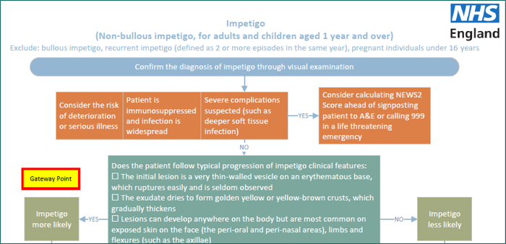
Clinical pathways consultations
Service spec and seven clinical pathways
23 associated PGDs and one clinical protocol (P med)
The clinical pathways contain one or more Gateway points
For a patient to be eligible to receive a Clinical pathways consultation, a Gateway point must be passed

Slide 16
High-level service overview [option 1]
Electronic referral from GP practice
[You may want to consider using this overview rather than the full one on the next slide as this is specific to general practice – one of the slides should be deleted before presenting]
Urgent repeat meds referral (GP practices cannot make referrals
Gateway
met
Minor illness referral
Clinical pathway referral
Gateway
met
Gateway
not met
Gateway
not met
Urgent repeat meds consultation
Minor illness consultation
Clinical pathway consultation
A more detailed service pathway diagram can be found in Annex A of the service spec

Slide 17
High-level service overview [option 2]
Referral
Electronic referral
Patient presents to the pharmacy
Gateway
met
Urgent repeat meds referral
Minor illness referral
Clinical pathway referral
Gateway
met
Gateway
not met
Gateway
not met
Urgent repeat meds consultation
Minor illness consultation
Clinical pathway consultation
Self-care Essential service
A more detailed service pathway diagram can be found in Annex A of the service spec

Slide 18
The service requirements
The pharmacy must have a consultation room, with access to IT equipment for record keeping​
Must have an otoscope (for acute otitis media clinical pathway) – except distance selling pharmacies who cannot provide this pathway
With consent, the patient’s GP record (e.g. via GP Connect Access Record), national care record or an alternative clinical record for the patient, must be checked by the pharmacist unless there is good reason not to do so
Must have an NHS-assured clinical IT system​
Where supplies of an NHS medicine are made, the normal prescription charge rules apply

Slide 19
The clinical pathways and PGDs

Slide 20
Clinical pathway consultations
The clinical pathways element will enable the management of common infections by community pharmacists through offering self-care, safety netting advice, and only if appropriate, supplying a restricted set of medicines to complete episodes of care for seven common conditions
NHSE commissioned Specialist Pharmacy Service to develop patient group directions (PGDs) and the clinical protocols for the service
The final PGDs and protocol, published on the NHSE website, have received national approval from the National Medical Director, Chief Pharmaceutical Officer and National Clinical Director for IPC & AMR
Pharmacists cannot deviate from the clinical pathways and PGDs

Slide 21
Development of clinical pathways
Multi-professional expert working group to develop robust clinical pathways for each of the 7 conditions
Adherence to NICE guidelines
National template for PGDs developed by SPS
Pharmacy Quality Scheme antimicrobial stewardship foundation
AMR Programme Board Oversight National Medical Director and Chief Medical Officer for England

Slide 22
Monitoring and surveillance
NHSE is closely monitoring delivery of the Pharmacy First service to allow for robust oversight and to look for any potential impact on antimicrobial resistance so that any needed mitigations can be quickly actioned
NHSE is working with the NHSBSA to enable pharmacy reimbursement and functionality for PGD supply to be recorded via ePACT2 data, or in a parallel dashboard
NIHR has commissioned an evaluation of the Pharmacy First service which will consider the implications for antimicrobial resistance

Slide 23
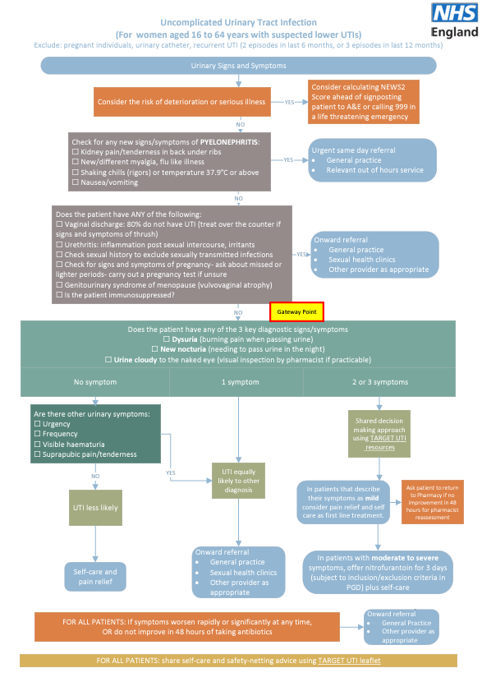

Slide 24
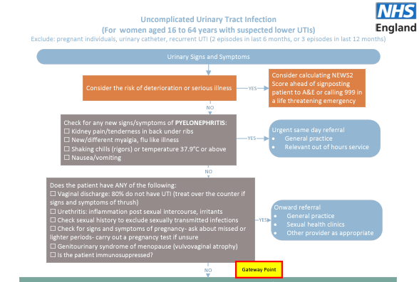

Slide 25
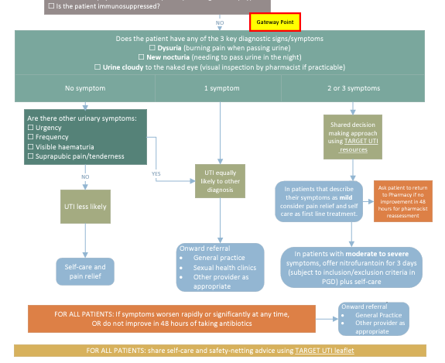

Slide 26
Notifications and referrals to general practice

Slide 27
Notifications
A patient’s general practice will be notified on the day of provision of the service or on the following working day
Where possible, sent as a structured message in real time via the NHS-assured IT system
NHSmail as a back-up
Minor illness and clinical pathway consultations – GP Connect Update Record will provide the functionality to automatically update a patient’s GP medical record

Slide 28
Referrals
If a patient needs to see a professional in their GP practice, after agreeing this course of action, the pharmacist should contact the patient’s GP practice
If it is known that a patient has used the service more than twice within a month, with the same symptoms and no indication for urgent referral, pharmacists will consider referring the patient to their GP practice

Slide 29
Learning and development for pharmacists

Slide 30
Learning and development
Pharmacy First self-assessment framework – developed by the Centre for Pharmacy Postgraduate Education (University of Manchester) and NHS England
Personal development action plan
Clinical examination training also available funded by NHS England
Lots of support to upskill and give pharmacists the confidence to offer this service

Slide 31
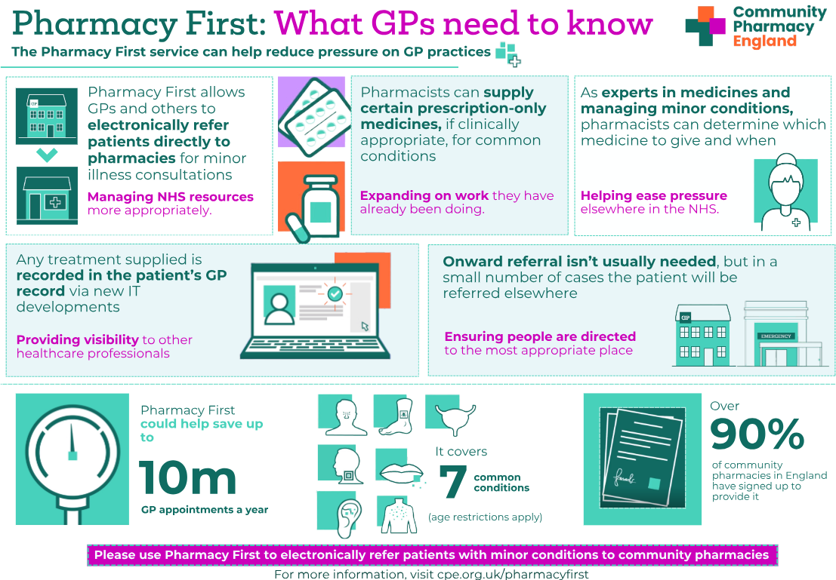
Summary

Slide 32
Expansion of other community pharmacy services

Slide 33
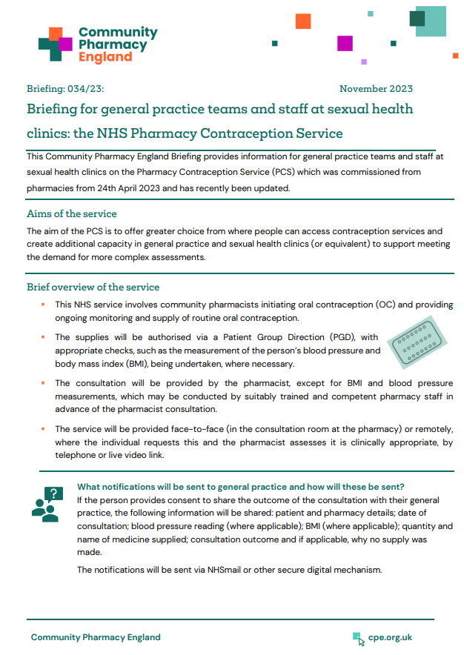
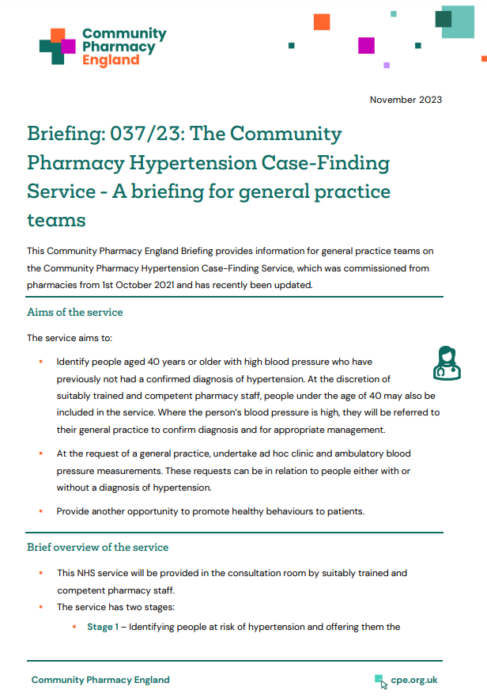
Expansion of other services
From 1st December 2023:
The Pharmacy Contraception Service was expanded to allow pharmacists to also initiate oral contraception (OC)
Previously they were only able to provide ongoing monitoring and repeat supplies of OC when this had been initiated at a GP practice or sexual health clinic
The Hypertension Case-Finding Service was expanded to allow suitably trained and competent pharmacy staff to provide the service
Previously only pharmacists and pharmacy technicians could provide the service
General practice briefings available at cpe.org.uk/briefings

Slide 34

Questions

